Slide 1
Micro
Affirmations:
Building
Inclusive
Culture
Through
Tangible
Actions

Slide 2


Service Standards
Courteous​
Responsive​
Effective​
Efficient

Slide 3
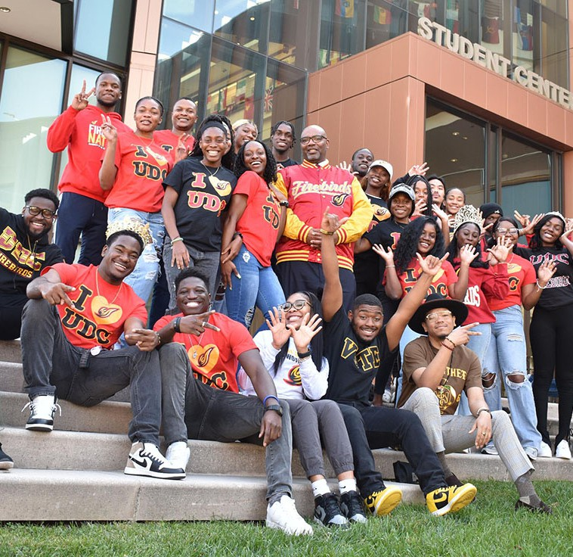

UDC Core Values​
These principles set by the University of the District of Columbia should be exemplified by each member of the campus:
Collaboration
Innovation
Integrity
Sustainability
Excellence
Inclusion

Slide 4

UDC’s Vision Statement​
Establish UDC as a leading National Public Urban University through:
1. Excellence in student achievement
2. Strong alignment with local workforce needs
3. Impactful service to the community

Slide 5

Agenda​
Investment in ALL OF YOU
Micro-Affirmations & Micro-Inequities - Learn What Has Shaped People – See People Not Just as Workers
Find Out How People Feel – Active Listening Skills
Confront Stereotypes Head On – Leverage Your Position to Model Inclusive Behaviors – Lead By Example
Bring Bias to the Forefront – Lead Through Cognitive Awareness
Action Planning

Slide 6
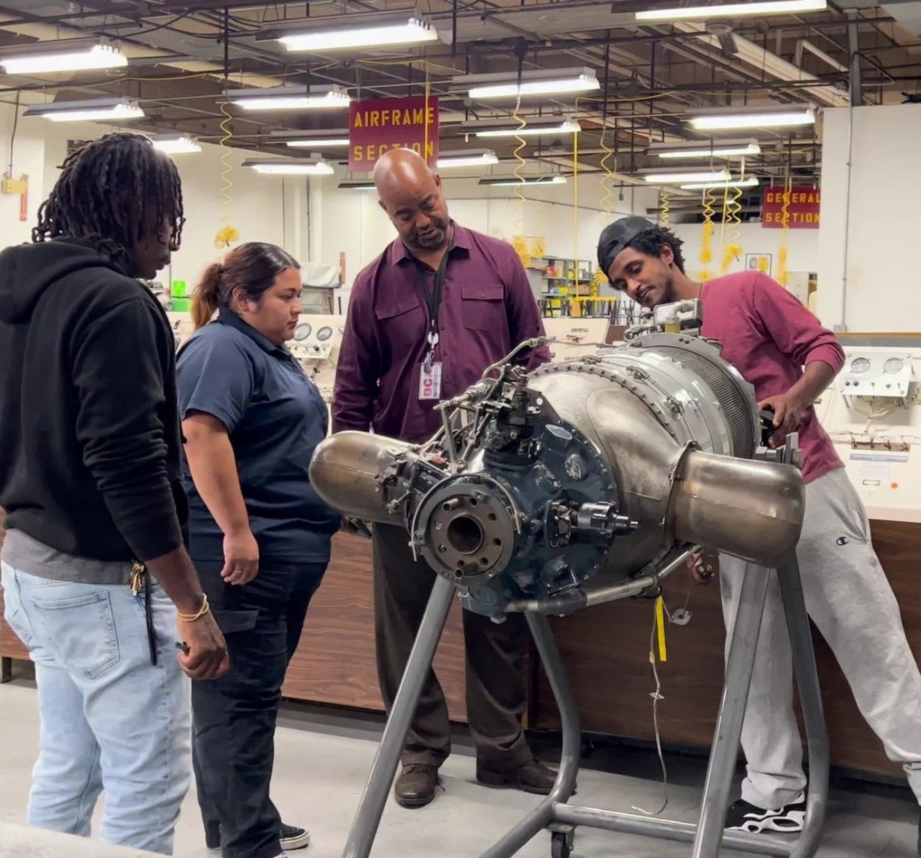
What are Micro-Affirmations?​
Micro-affirmations: subtle acknowledgements of a person’s value and accomplishments, creating a sense of belonging and opening doors to opportunities; publicly attributing credit for acts of appreciation, a meaningful thank you, a kind introduction, and inviting someone to attend a meeting/committee to represent the team. Subtle yet powerful ways to motivate:
  Gestures of inclusion & caring
  Graceful acts of listening
  Generosity in consistently giving credit to others
  Providing comfort and support to others in distress

Slide 7

What are Micro-Inequities?​
Micro-inequities – a comment or action that devalues, discourages, and ultimately affects performance; demoralizing, marginalizing, or demeaning a person, which may or may not be intended but carries weight and has a significant impact. Derived from internal biases, which we all possess, but doesn’t excuse or allow unfavorable behavior. ​
Messages that devalue or discourage:​
  Comments that impair workplace performance​
  Not being invited to a particular meeting​
  Not being given the requisite attention when making a speech or presentation​
  Not being introduced properly to a new employee​
  Unfair annual performance appraisals - little or no justification​
NOTE: Micro-aggression is a comment or action that negatively targets a marginalized group of people.​
Gestures - Words - Tone

Slide 8

Learn What Has Shaped People
(Exercise)
Create a safe space to learn about your teammates’ backgrounds and what has been vital in shaping their lives. Doing this as a group allows people to learn new things about each other that otherwise might not come up, and the act of being open, honest, and vulnerable is a great way to form bonds, increase empathy, and improve your relationships.​
​
Ask everyone to think about the three most defining moments in their lives and write them down on separate post its.​
Have each person present these moments to the team, and share their story to whatever degree they feel comfortable.​
Thank everyone for sharing, and ask the team to share what their takeaways are from the exercise.​

Slide 9
What is Active Listening?​
One of the most important skills you can have which has a major impact on your job effectiveness and the quality of relationships. ​
​
When you practice in active listening, you need to put the attention and concentration on what someone is saying. You listen using all of your senses and give attention to the person who is talking. Feedback can be verbal (be mindful of your tone) and nonverbal include signs such as eye contact, mirroring, smiling, and leaning in.​
​
Active Listening Exercise – ​
Empty Your Cup ​

Slide 10

Exercise - Empty Your Cup​
We recognize that people come to training with a lot of work to be completed. We also recognize that people have varying feelings and interpretations about diversity, equity & inclusivity topics. ​
​
We are going to give you a moment to “empty your cup” to be fully present for this workshop. ​
​
There will be an A and B. A is to empty their cup while B listens for two minutes. Then switch roles. Report our experiences.​

Slide 11
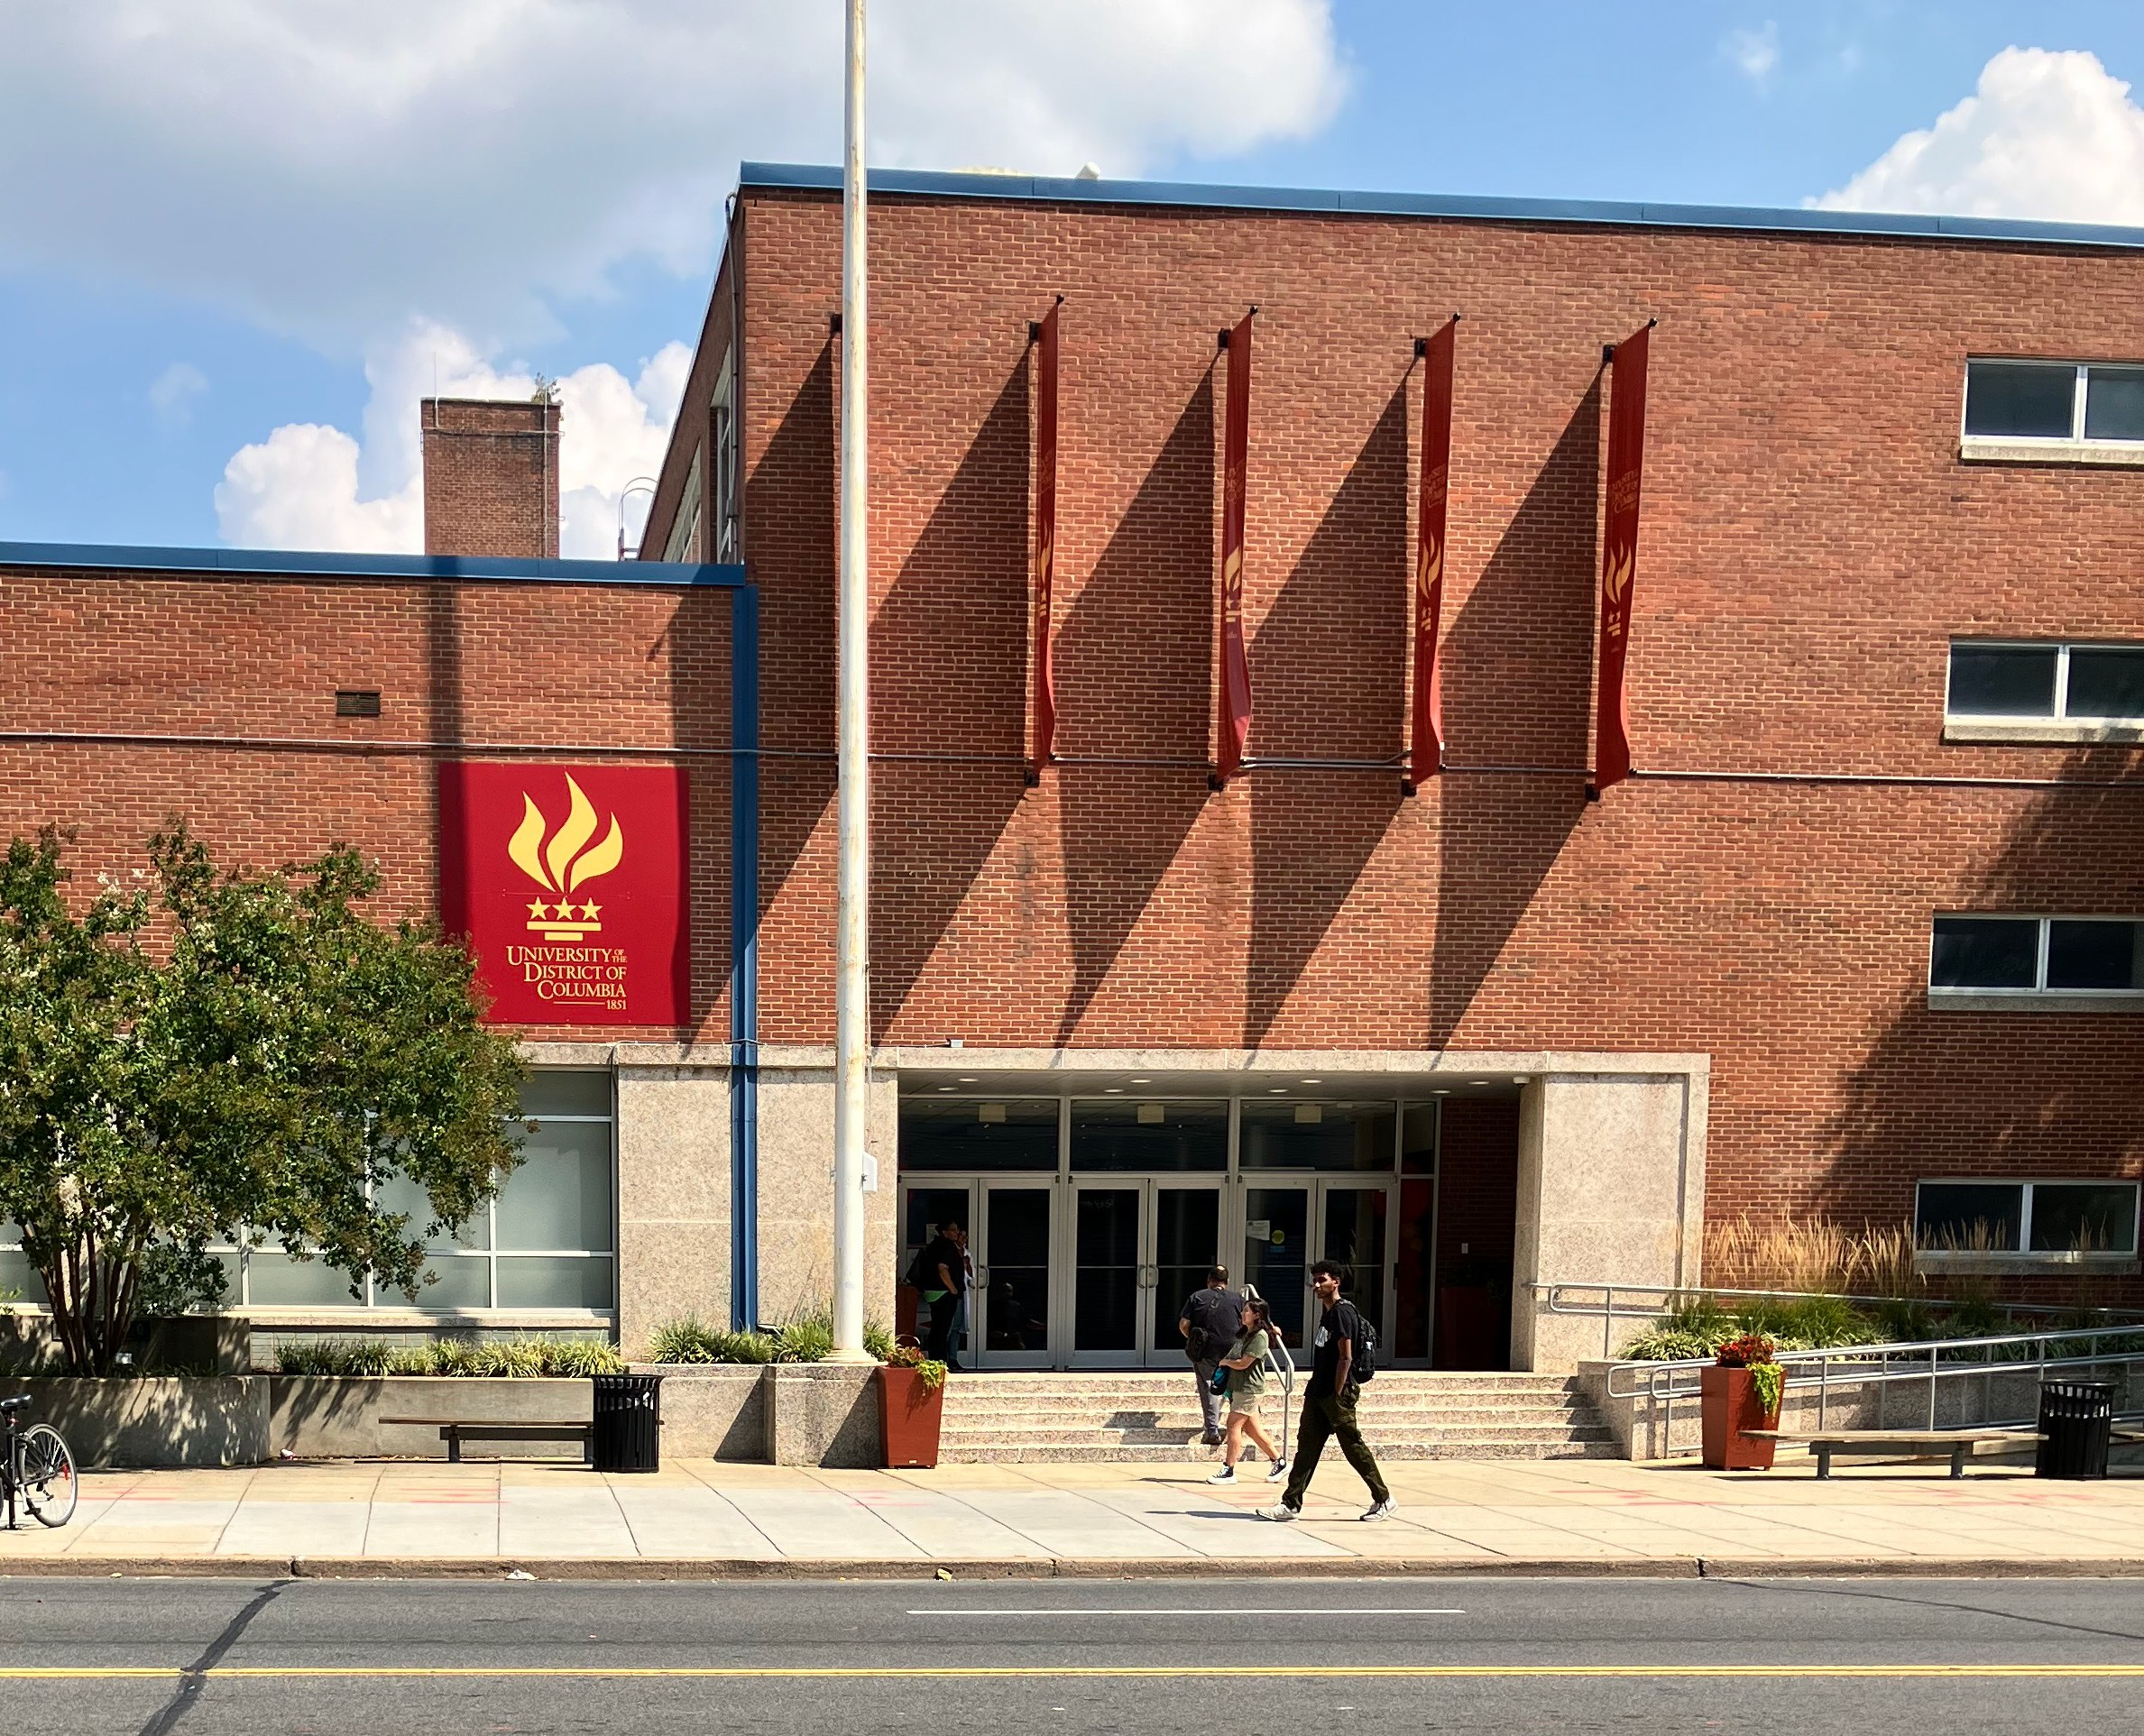
Stereotypes
Exaggerated descriptions lump people with certain characteristics into one group.​
​
Examples:​
  Women are more emotional than men​
  Men can never find things​
  Millennials are not very ambitious​
  Baby Boomers aren’t very tech savvy​

Slide 12

Confront Stereotypes and Biases
Whether or not you confront someone else's behavior, everyone can benefit from being aware of and confronting their own stereotypes and biases. “Turn the flashlight on yourself”.
Try the following exercise when you meet someone new:
  Ask yourself what first impressions come to mind.
    Do you think this person is intelligent? Why or why not?
    Do you think this person is a hard worker? Why or why not?
  Are you reminded of someone else you know from a past experience?
    If so, is this a positive or negative memory?
    Because of this memory, do you feel more or less likely to trust this person?
After answering these questions you can see how your own stereotyping and biases may affect how you view people. Once you are aware of a possible bias, it is easier to confront the issue and try to make a more objective decision.

Slide 13
Unconscious Bias
All humans have bias- Much of it we are unaware of – it is unconscious. Our biases affect us and our decision-making processes in several different ways:​
Our Perception – how we see people and perceive reality.​
Our Attitude – how we react towards certain people.​
Our Behaviors – how receptive/friendly we are towards certain people.​
Our Attention – which aspects of a person we pay most attention to.​
Our Listening Skills – how much we actively listen to what certain people say.​
Our Micro-affirmations – how much or how little we comfort certain people in certain situations.​

Slide 14
Unconscious Bias
Here are five types of unconscious bias that may affect our decision-making as follows:
1. Anchoring Bias – is a cognitive bias that describes the common human tendency to rely too heavily on the first piece of information offered when making decisions and subsequent judgments.
2. Affinity Bias – occurs when we see someone we feel we have an affinity with (e.g. attend the same college, grew up in the same town, reminds us of someone we know and like).
3. Halo Effect – when we see one great thing about a person, and we let the halo glow on that significant thing, affect our opinions about everything else about that person.

Slide 15
Unconscious Bias
4. Horns Effect – it is when we see one bad thing about a person and we let it cloud our opinions of their other attributes.
5. Similarity Bias – we want to surround ourselves with people we feel are similar to us, and as a result, we tend to want to work more with people who are like us.
Please share an individual story that you experienced as a result of unconscious bias.

Slide 16
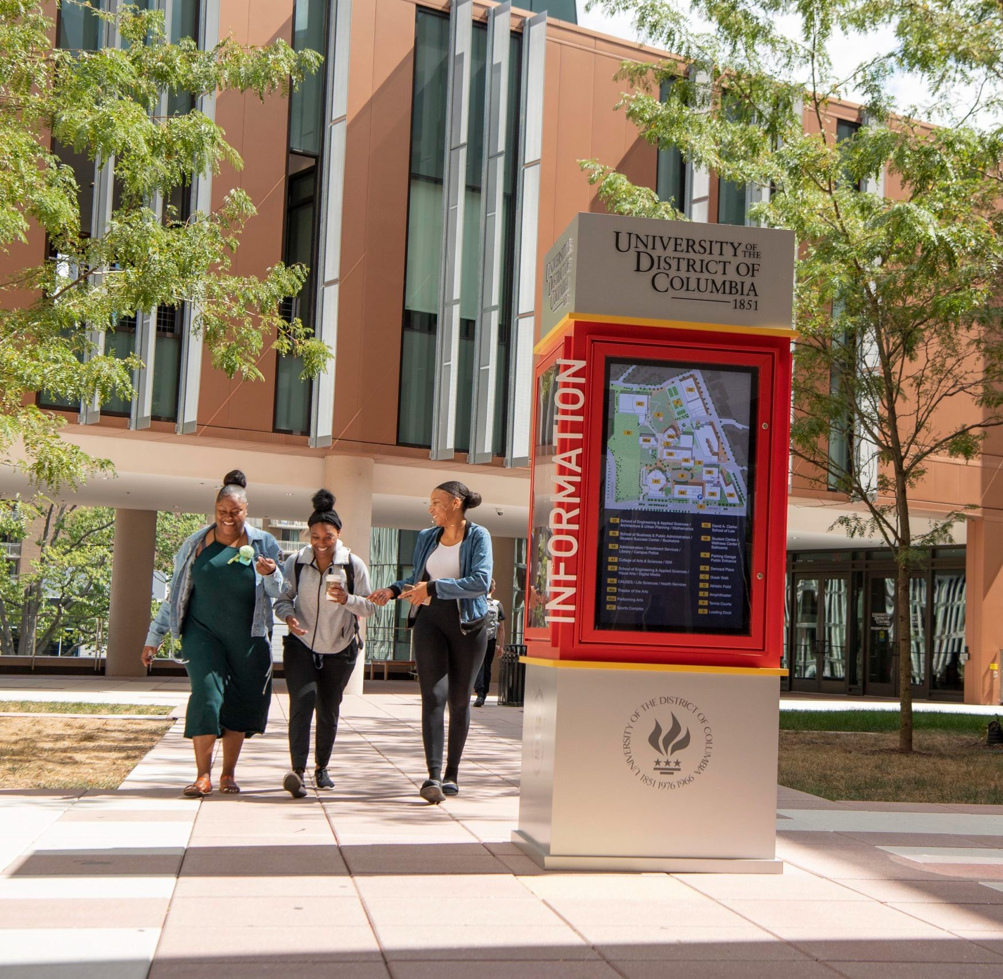
Emotional Intelligence in the Workplace
Emotional intelligence is the ability to recognize and understand emotions in oneself and others. In turn, this emotional understanding helps us make decisions, solve problems, and communicate with others within the workplace.​
​
It is also a skill that researchers believe can be improved with training and practice such as: ​
Become More Self-Aware​
Practice Self-Regulation​
Improve Social Skills​
Become More Empathetic​
Work on Your Intrinsic Motivation​

Slide 17
Emotional Intelligence in the Workplace
People With High EI​
​
Make better decisions and solve problems​
Keep cool under pressure​
Resolve conflicts​
Have greater empathy​
Listen, reflect, and respond to constructive criticism​
​
People With Low EI​
Play the role of the victim or avoid taking responsibility for errors​
Have passive or aggressive communication styles​
Refuse to work as a team ​
Are overly critical of others or dismiss others' opinions​

Slide 18
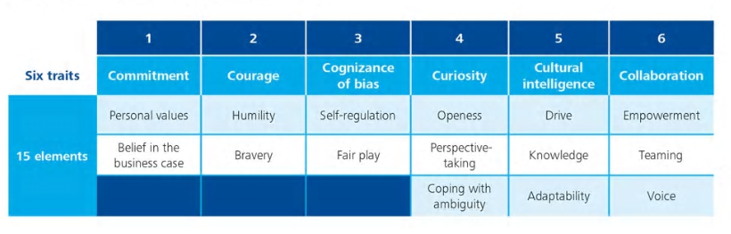
Six Signature Traits of Inclusive Leadership

Slide 19
Modeling Inclusive Behaviors​
Invest in People/Team​
Empowerment: Enabling direct reports to develop and excel​
​
Humility: Admitting mistakes; learning from criticism and different points of view; acknowledging and seeking contributions of others to overcome one’s limitations​
​
Courage: Putting personal interests aside to achieve what needs to be done; acting on convictions and principles even when it requires personal risk-taking​
​
Accountability: Demonstrating confidence in direct reports by holding them responsible for performance they can control

Slide 20
Lead Through Cognitive Awareness – ​ Self Assessment Exercise
Do you: ​
Ask for feedback from others about your work?​
Leave an appreciative note or thank you for assisting to recognize efforts?​
Interrupt others while they are speaking….or roll your eyes?​
Raise your voice to get your point across?​
Hold yourself accountable when you make a mistake?​
Recognize someone new to the team?​
Give proper credit on a project?​
Are you supportive of others’ ideas during team meetings?​
​
What would you change about yourself….about your approach? ​
​

Slide 21
Action Planning
Record specific steps you will take to contribute to a positive, civil and respectful work environment within the next 10 days.​
I will get to know an EMPLOYEE’S NAME more as an individual by DATE. ​
Think of a diversity or cultural situation or breakdown that you were a part of. What interpretations did you have about the other person and the incident? Where might those interpretations have come from? How can I remedy the situation? ​
Rectify a past negative situation that occurred out of bias, ignorance or miscommunication. ​
Identify members of your immediate team or your coworkers who may be excluded more than others and include them at a lunch or meeting. ​

Slide 22
Action Planning
Intentionally include people from other functional and skill areas on your problem-solving teams. ​
Identify someone with whom you are in conflict. Explore whether this is due to your acting on stereotypes or assumptions you have made. Take the opportunity to explore and talk with that person. ​
Have discussions as a team/committee about various topics to make sure that our practices are inclusive. ​
Be part of a workplace or community committee to network and create productive relationships. ​

Slide 23
