Slide 1



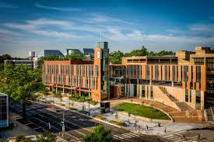
Effective Communication
Pl
An Investment in all of YOU

Slide 2

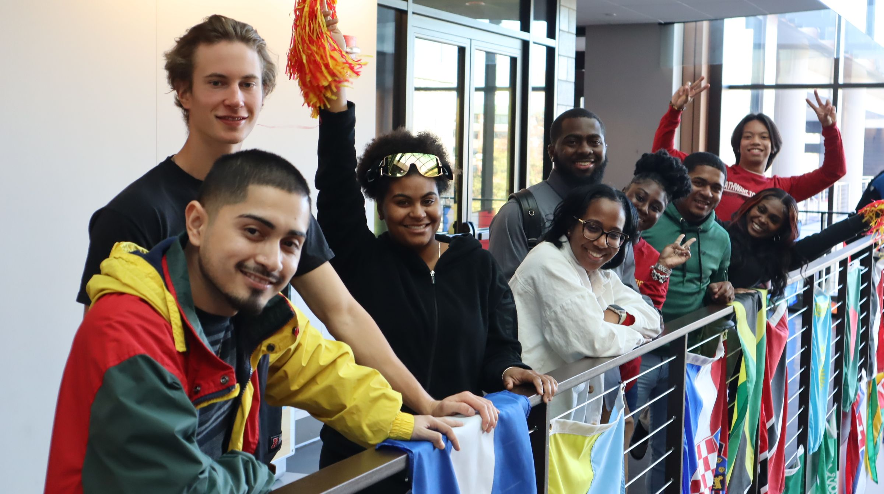
Service Standards
3
Courteous
Responsive
Effective
Efficient

Slide 3

UDC Core Values
are principles set by the University of the District of Columbia that should be exemplified by each member of the campus:
Collaboration
Innovation
Integrity
Sustainability
Excellence
Inclusion

Slide 4
UDC’s Vision Statement
3
Establish UDC as a leading National Public Urban University through:
1. Excellence in student achievement
2. Strong alignment with local workforce needs
3. Impactful service to the community

Slide 5
Effective Workplace Communication
Effective workplace communication is about making that connection with others in your organization and creating an environment where everyone feels included and heard. It’s about communicating in a way that allows your team to accomplish its goals and make progress.
What we mean by effective workplace communication:
Getting the information that you need in order to do your job well, when you need it, from the people who can provide it.

Slide 6
Communication Habits
Be conscientious about your communication habits which means practicing effective communication skills and being a powerful communicator.
1. Your body language
Crossed or folded arms – Defensiveness
Hands held behind the body – Confidence
Mending clothes, accessories, watch – Nervousness
Clenched fists – Anger or anxiety
Squeezing hands – Self-soothing
2. Active listening
That means being completely present of what the speaker is trying to impart. Practice patience.
3. Delivering with confidence
You need to develop a strong delivery by being patient, kind to yourself, and slowing down.
4. Keep it Positive
Last but not least, try to stay positive. No matter whatever state of mind you are in, being positive will save you from getting into a bad conversation.

Slide 7
Communication Tip #1

Slide 8
Inform and Inspire
More than just passing on the information, be careful of explaining and clarifying your thoughts and ideas to have an effective one. Passing the information is just half the equation. Plan ahead what you want the audience to remember from the conversation.
Do you want them to take any kind of action? The most effective communication will make your people take action.

Slide 9
Communication Tip #2

Slide 10
Be an Active Listener
Employees who listen well tend to work better. Listening is twice as important as talking and one big important part of effective communication skills in business. Listening should not be taken for granted. Do not just sit back, barely awake, letting the speaker’s words wash over you. The more you listen well, the better you receive the information.
Do you know how to listen well? Here are a few tips…
Make eye contact with the speaker
Respond appropriately
No interruptions, please
Examine your body language

Slide 11
Examples of Workplace Communication
Team meetings
1:1 feedback sessions
Receiving information
Communicating about project status or progress
Collaboration on cross-functional tasks
Nonverbal communication

Slide 12
What Makes Communication Great?
Aims for clarity.
Whether you’re sending a message, drafting an email, or giving an off-the-cuff reply, aim to clearly communicate your message.
Seeks to solve conflicts, not create them.
The reason you’re communicating is to solve a problem or promote effective collaboration on a project or task. Great communication in the workplace breaks potential barriers and encourages feedback for resolution—but make sure the goal is to get to a better place than where you are now.
Goes both ways.
Every instance of communication in the workplace is an exchange of information—two way dialogue; be aware of your non-verbals.

Slide 13
The Benefits of Open Workplace Communication
Clear, effective workplace communication can:
Boost employee engagement and belonging
Encourage team buy-in
Increase productivity
Build a healthy workplace and inclusive culture
Reduce conflict (some conflict is good but be respectful & professional)
Increase retention

Slide 14

What Do People Want?
Clarity of expectations
Tools and training
Chance to do best work
Meaningful Recognition
A manager who cares
Encouragement
To be heard
To feel important/valued
Successful (team) relationships
Sense of ownership/responsibility

Slide 15
What Causes Conflict?
Lack of efficient and timely communication
Ineffective and unwillingness to listen to concerns and ideas – personalize the message
Perceived inequity of treatment compared to peer or peer groups
Mismatch of the employee’s skills and the requirements of the job
Unclear expectations or conflicting direction
Inadequate tools, information, and training
Lack of connection with co-workers
Personality conflicts
Resistance to change
Lack of self-awareness

Slide 16
What Happens When Employees Are Unhappy?
Tardiness/absenteeism
Productivity falls-both the employee’s and (often) the team’s
  Quality and Quantity of work falls and deadlines are missed
Customer service suffers
Stress and anxiety increase
  Leads to being out of work
Conflict increases, stress rises, and the results can escalate to violence

Slide 17
Establish a Professional Workplace
It takes ALL of us!
Lead by example
Understand policies, procedures and consequences of inappropriate conduct
Be aware of sensitive issues
Document events
Conduct discussions in a confidential manner
Be respectful in your conversation
Be a good listener

Slide 18
Deal With Conflict As It Happens
Acknowledge without blame or hostility that the conflict exists
Identify the specific behavior in which the conflict is rooted
Identify how the behavior is causing a roadblock to a good working relationship
Ask “What do you need from me?” or
“Help me understand the issue?”

Slide 19
Feel, Fact, Action
Feel: I am concerned with what I observed today. We are here to discuss the situation
Fact: You were raising your voice to others and were visibly angry and agitated. This disrupted the work area.
Action: Do you understand why your actions/behaviors were inappropriate?
  Recommendations: i.e. coaching session, progressive discipline, fitness for duty, reasonable accommodation, training
  Resources: HR, EAP

Slide 20
Create the Culture We Want
Share tips and encouragement
Learn from people who inspire you
Learn how to lead with trust
Align with your organization
See if your team is clear on your organization’s vision
Identify systems that need to change
Identify behaviors that need to change
Practice generosity
Be kind to one another
Recognize one another
Must be accountable for what we say and do

Slide 21
Important Contacts
Marie Armstrong
Benefits Coordinator
General Inquiries
202-274-5380
www.udc.edu
Shawn Celio
VP, HR
Dr. M. Aloysius Simpson, Dir. ODL
Dominique Jackson, Man. Talent Acquisition
Noelia Ramirez, HR Project Manager
Calvin Stover, Dir. Employee Labor Relation

