Slide 1
Building a Championship Culture
Facilitators: Dr. M. Aloysius Simpson
(Director of ODL)
Shawn Celio (Vice President of HR)

Slide 2
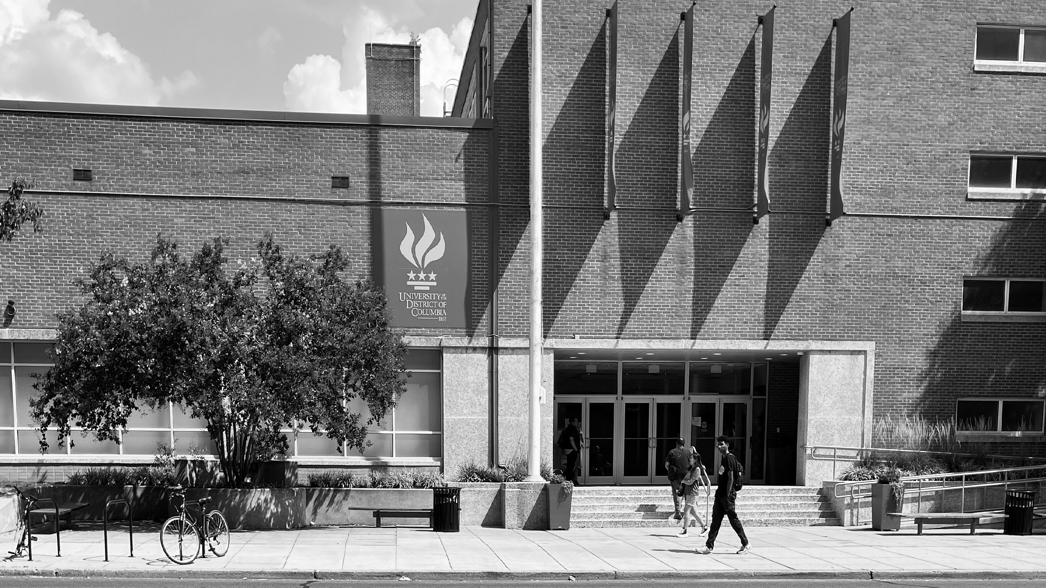

Service Standards
Courteous​
Responsive​
Effective​
Efficient​

Slide 3
UDC Core Values
are principles set by the University of the District of Columbia that should be exemplified by each member of the campus:​
​
Collaboration​
Innovation​
Integrity​
Sustainability​
Excellence​
Inclusion​

Slide 4

UDC’s Vision Statement
Establish UDC as a leading National Public Urban University through:
1. Excellence in student achievement
2. Strong alignment with local workforce needs
3. Impactful service to the community

Slide 5
What does it take to build a Culture of Commitment, Accountability, and Ownership at our University?

Slide 6
A Championship Culture - Defined
A championship culture is a term used to describe a set of values, beliefs, and behaviors that are shared by a team or organization. It is characterized by a strong sense of purpose, commitment, and accountability amongst its members. ​​
​​
A championship culture matters because it sets the foundation for success. It creates an environment where individuals are motivated to give their best effort, work together as a team, strive for excellence and work together as a team towards a common goal. When everyone is aligned with the vision and values of the culture, it leads to improved performance, increased cohesion, and ultimately, the achievement of goals.​​

Slide 7


​
Six Key Components of a Championship Culture
Credible leaders
Clear and compelling vision
Core Values
Standards of behavior
Committed and unified team members
Aligned systems

Slide 8
Credible Leaders​
Credible leaders are the first and potentially most critical component of developing a Championship Culture. Your team leaders set the tone for the program by designing, developing, and driving the culture through the rest of the team. Two-way dialoguee enhances effective communication and the exchange of feedback.​
​
In a championship culture, there is almost always one primary leader who serves as the key catalyst and coordinator of all the multi-layered leadership efforts. This person is typically the head of the department who is obviously best positioned to have this kind of influence and impact on the rest of the team.

Slide 9
Clear and Compelling Vision
Championship Cultures have a clear and compelling vision. This means the team members must know exactly what you want to achieve and why you want to achieve it. The purpose of your role in the institution is clear. This clear and well-articulated vision helps everyone focus and streamline their efforts on doing what it takes to achieve departmental goals.
The vision must be something that people are innately drawn to, passionately yearn for and are willing to make the sacrifices for. People should be so caught up in and excited about the vision that it passionately motivates them on a daily basis and maintains their commitment.

Slide 10
Core Values​
Core Values are the unshakeable bedrock principles that your program believes are absolutely foundational to your success. They are what your program definitively values and stands for - no matter what the situation. ​
​
These nonnegotiable, sacred values define the essence of your program and are expected to be shared by everyone because they are so central to what your program is all about. ​
​
These Core Values serve as the true North for your department and all decisions you make should revolve around them.

Slide 11
Rules of Engagement
Work horizontally before working vertically. ​
Always speak well of each other and the University. ​
Observe the chain of command as appropriate. ​
Stop placing blame. ​
Protect confidences. ​
Share ideas with each other. ​
Practice civility and collegiality. ​
Recognize that the University is first and that we are here for the students ​

Slide 12
Standards of Behavior​
Emanating from core values are your department’s Standards of Behavior. These standards revolve around the specific actions expected of each team member in various contexts. ​
​
The Standards of Behavior are the daily choices and actions that either maximize (support) or minimize (undermine) the chances of your vision becoming a reality - and your values being practiced and upheld.

Slide 13
Standards of Behavior
To have a championship culture, your standards of behavior must be set at a very high level. ​
Rather than complaining about these high standards or looking to subvert them, your leaders, managers/supervisors, and colleagues should fully embrace them because they are necessary for high-level success. It takes a total team effort!​
The high standards are seen as an edge and as important differentiators in outworking, out-training, and out-competing other institutions

Slide 14
Committed and Unified Team Members
Championship Cultures contain energized and engaged team members who fully embrace the vision, values, and standards of the culture. ​
By building a Championship Culture, your team members will take pride in being a part of your department and the University by accepting total responsibility for passionately playing their part. They will know that they are a valuable and vital part of your team’s successes and will give their full commitment to the University.​

Slide 15
Committed and Unified Team Members​
Team members in a Championship Culture become unified around your vision, values, and standards and willingly subvert their individual goals and agenda in service of something larger than themselves. ​
They selflessly place the group’s best interest above their own.​

Slide 16
Aligned Systems - Sustaining the Culture​
Championship programs implement systems and processes designed to develop, reinforce, and sustain the culture. ​
​
These dedicated and well-designed systems provide the internal structure of your culture, and ensure that key principles are emphasized, and important processes are completed in alignment with your vision, values, and standards.​

Slide 17
Aligned Systems - Sustaining the Culture​
Championship Cultures create several specific systems for selection, execution, evaluation, recognition, correction, and succession. All of these various systems are developed, tweaked, and perfected over time to promote and support the Vision, Values, and Standards of your program on a daily basis. ​
By developing and aligning your systems, you build a sustainable, self-perpetuating, virtuous cycle that ensures you obtain, develop, and keep the right kind of people and practices within your culture.​

Slide 18
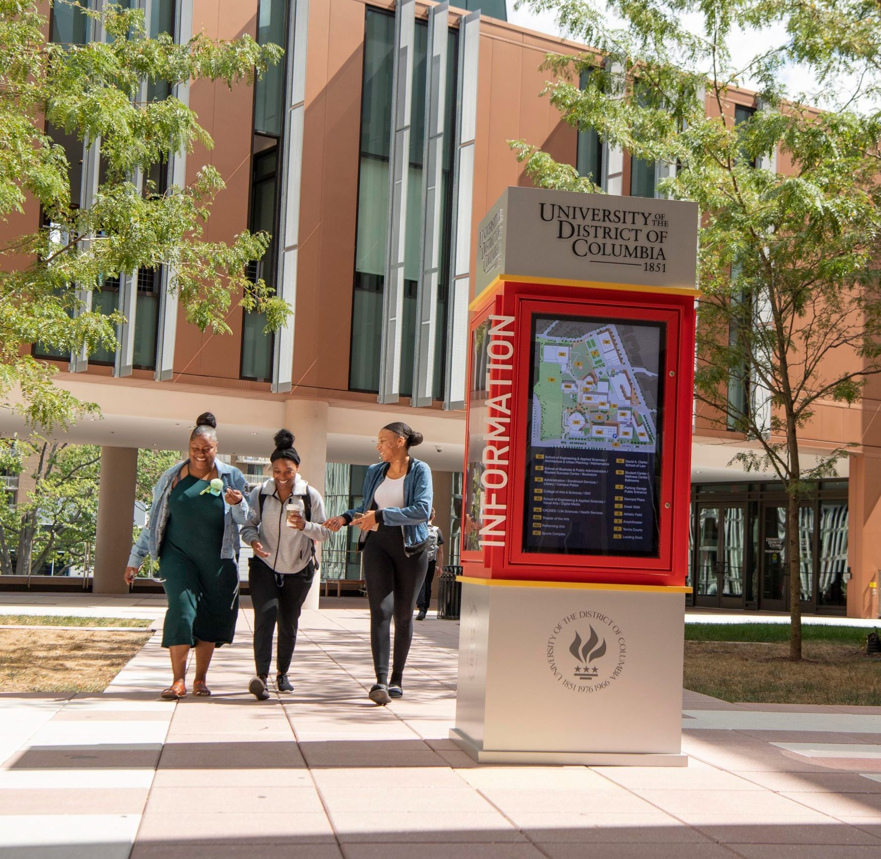

Six Signature Traits of Inclusive Leadership​
​
Commitment​
​
Courage​
​
Cognizance of bias​
​
Curiosity​
​
Cultural Intelligence​
​
Collaboration​
​

Slide 19
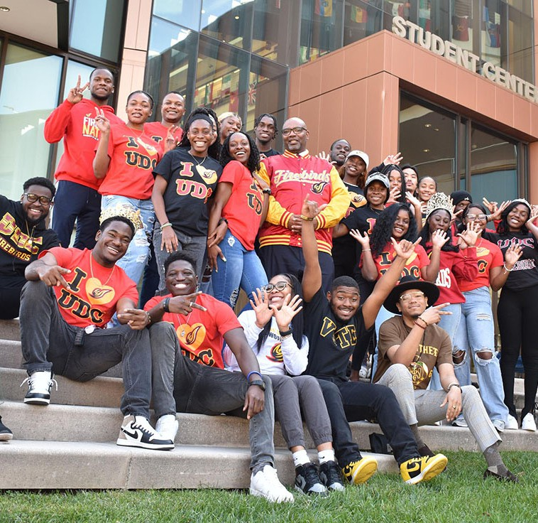
Modeling Inclusive Behaviors​
Invest in The Team​
Empowerment: Enabling people to develop and excel.​
Humility: Admitting mistakes; learning from criticism and different points of view; acknowledging and seeking contributions of others to overcome one’s limitations.​
​Courage: Putting personal interests aside to achieve what needs to be done; acting on convictions and principles even when it requires personal risk-taking.​
​Accountability: Demonstrating confidence in people by holding them responsible for performance they can control.

Slide 20
Lead Through Cognitive Awareness – ​
Self Assessment Exercise Action Plan
Do you: ​
Ask for feedback from others about your work?​
Show gratitude or leave an appreciative note to recognize the efforts of others?​
Interrupt others while they are speaking….or roll your eyes?​
Raise your voice to get your point across?​
Hold yourself accountable when you make a mistake?​
Recognize someone new to the team?​
Give proper credit on a project?​
Are you supportive of others’ ideas during team meetings?​
​
What would you change about yourself….about your approach? ​
Remember, your collective goal is to build a championship culture​
​

Slide 21
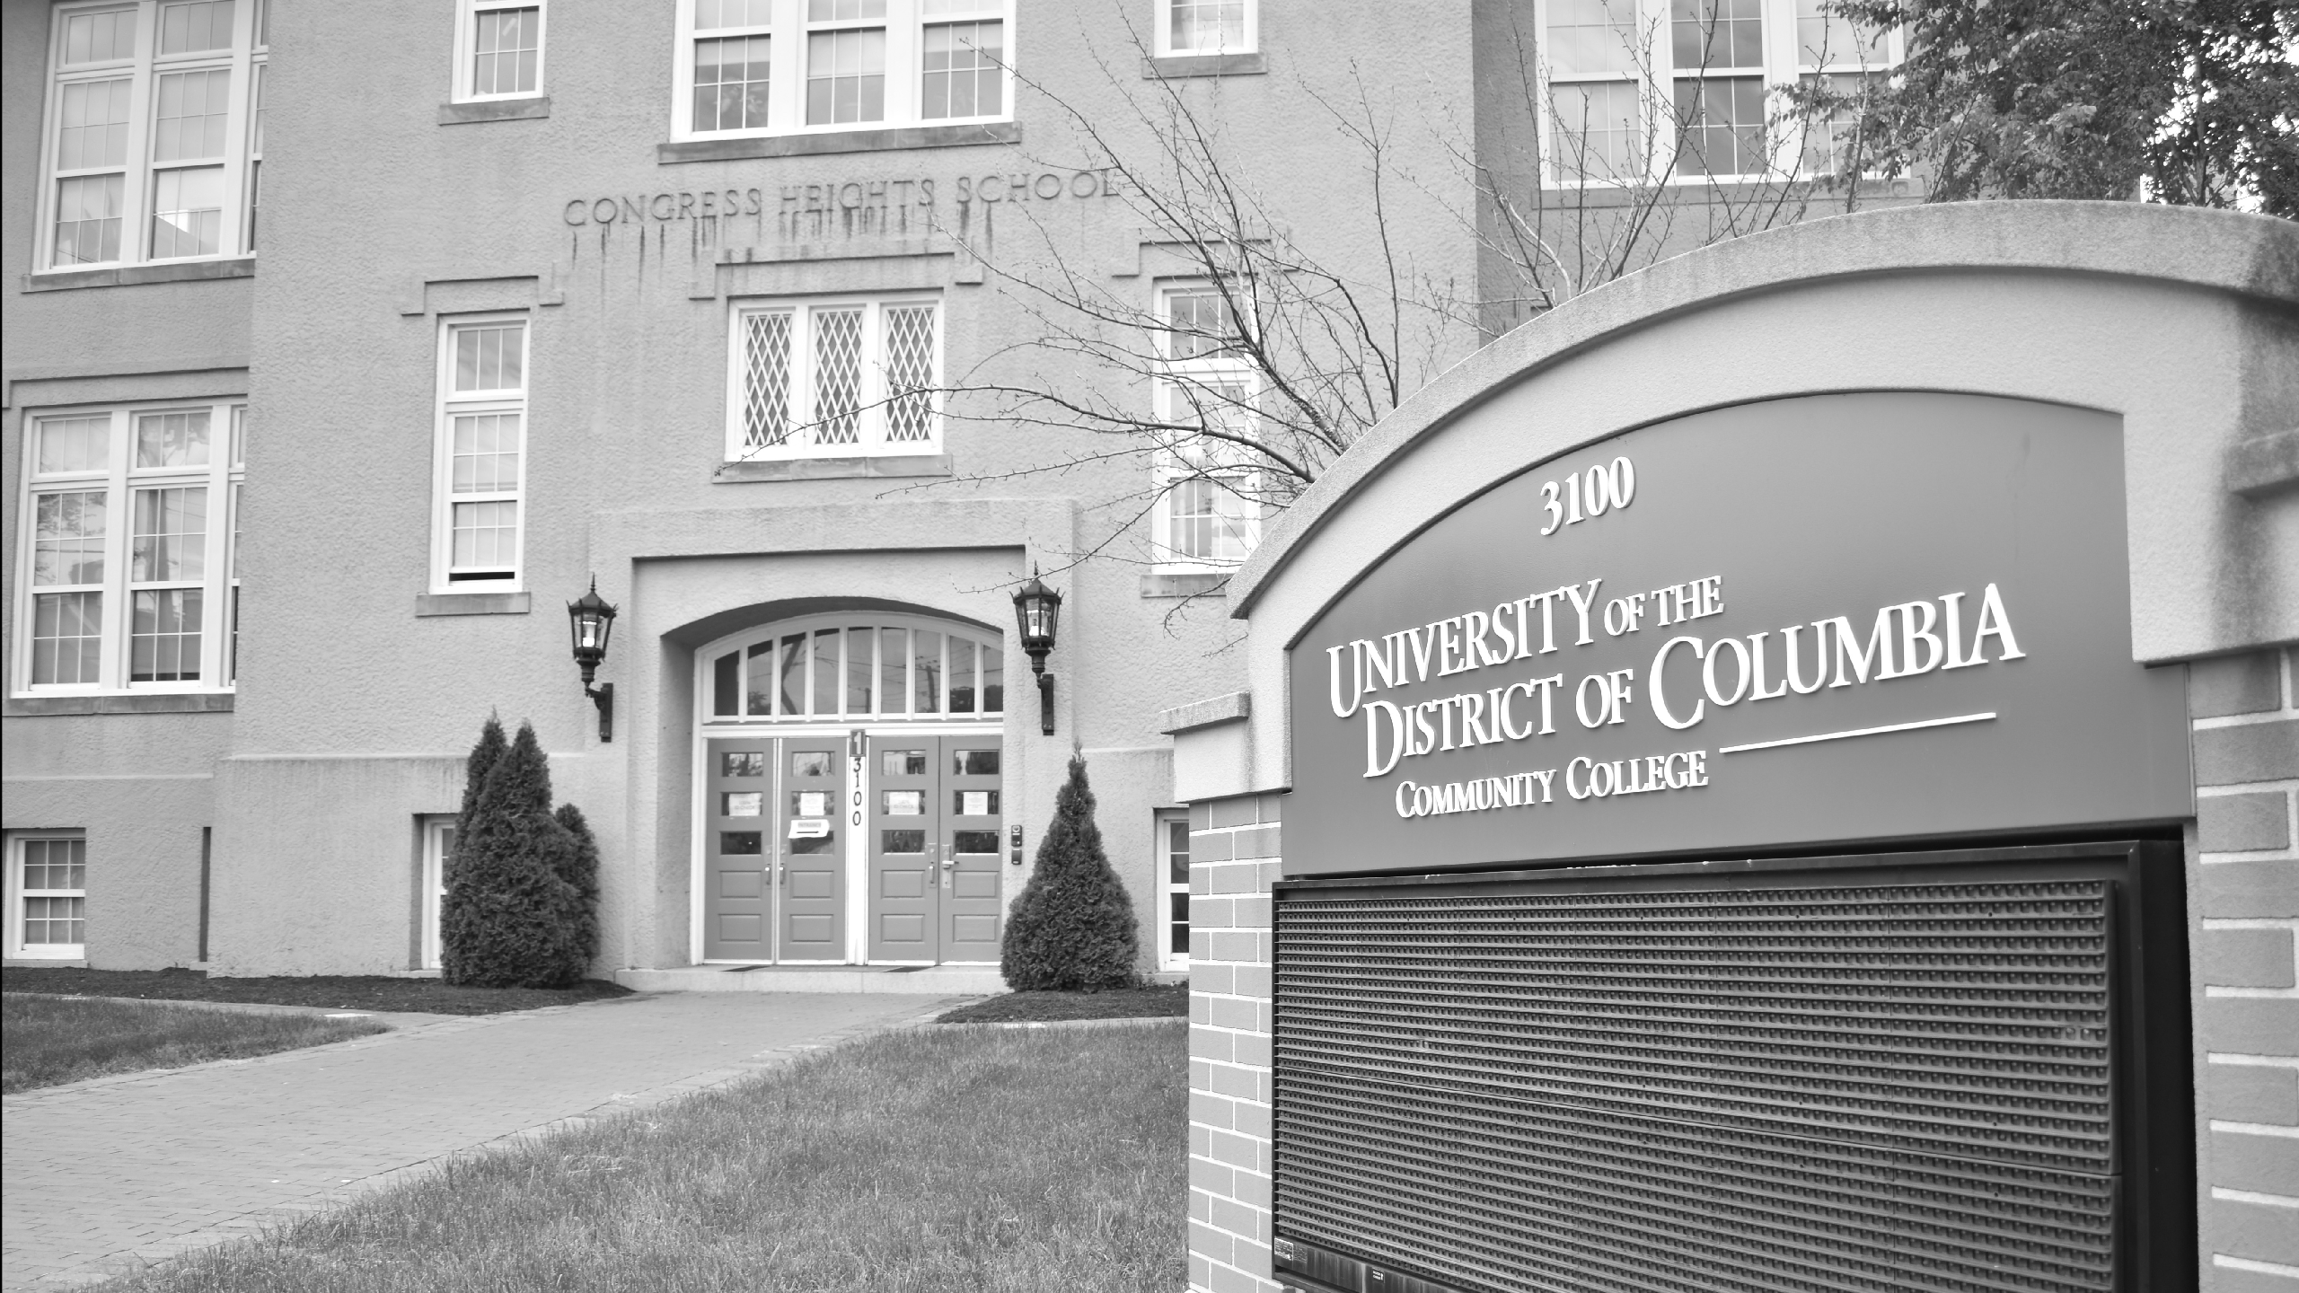

THANK YOU, now give yourselves
a hand

